Slide 1
Natural Language Processing
Rada Mihalcea
Fall 2011

Slide 2
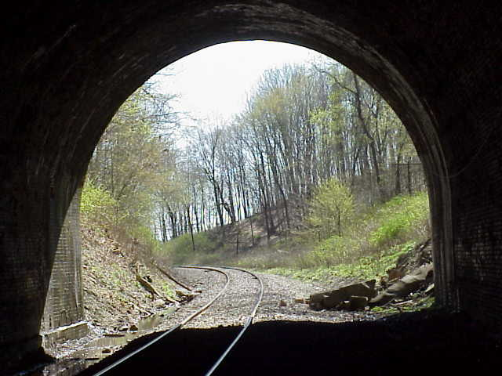

Any Light at The End of The Tunnel?
Yahoo, Google, Microsoft → Information Retrieval
Monster.com, HotJobs.com (Job finders) → Information Extraction + Information Retrieval
Systran powers Babelfish → Machine Translation
Ask Jeeves → Question Answering
Myspace, Facebook, Blogspot → Processing of User-Generated Content
Tools for “business intelligence”
All “Big Guys” have (several) strong NLP research labs:
  IBM, Microsoft, AT&T, Xerox, Sun, etc.
Academia: research in an university environment

Slide 3
Why Natural Language Processing ?
Huge amounts of data
  Internet = at least 20 billions pages
  Intranet
Applications for processing large amounts of texts
require NLP expertise
Classify text into categories
Index and search large texts
Automatic translation
Speech understanding
  Understand phone conversations
Information extraction
  Extract useful information from resumes
Automatic summarization
  Condense 1 book into 1 page
Question answering
Knowledge acquisition
Text generations / dialogues

Slide 4
Natural?
Natural Language?
  Refers to the language spoken by people, e.g. English, Japanese, Swahili, as opposed to artificial languages, like C++, Java, etc.
Natural Language Processing
  Applications that deal with natural language in a way or another
[Computational Linguistics
  Doing linguistics on computers
  More on the linguistic side than NLP, but closely related ]

Slide 5
Why Natural Language Processing?
kJfmmfj mmmvvv nnnffn333
Uj iheale eleee mnster vensi credur
Baboi oi cestnitze
Coovoel2^ ekk; ldsllk lkdf vnnjfj?
Fgmflmllk mlfm kfre xnnn!

Slide 6
Computers Lack Knowledge!
Computers “see” text in English the same you have seen the previous text!
People have no trouble understanding language
  Common sense knowledge
  Reasoning capacity
  Experience
Computers have
  No common sense knowledge
  No reasoning capacity

Slide 7
Where does it fit in the CS taxonomy?
Computers
Databases
Artificial Intelligence
Algorithms
Networking
Robotics
Natural Language Processing
Search
Information
Retrieval
Machine
Translation
Language
Analysis
Semantics
Parsing

Slide 8
Linguistics Levels of Analysis
Speech
Written language
  Phonology: sounds / letters / pronunciation
  Morphology: the structure of words
  Syntax: how these sequences are structured
  Semantics: meaning of the strings
Interaction between levels

Slide 9
Issues in Syntax
“the dog ate my homework” - Who did what?
Identify the part of speech (POS)
  Dog = noun ; ate = verb ; homework = noun
  English POS tagging: 95%
2. Identify collocations
mother in law, hot dog
Compositional versus non-compositional collocates

Slide 10
Issues in Syntax
Shallow parsing:
  “the dog chased the bear”
  “the dog” “chased the bear”
  subject - predicate
  Identify basic structures
  NP-[the dog] VP-[chased the bear]

Slide 11
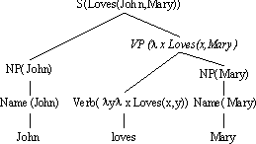
Issues in Syntax
Full parsing: John loves Mary
Help figuring out (automatically) questions like: Who did what
and when?

Slide 12
More Issues in Syntax
Anaphora Resolution:
“The dog entered my room. It scared me”
Preposition Attachment
“I saw the man in the park with a telescope”

Slide 13
Issues in Semantics
Understand language! How?
“plant” = industrial plant
“plant” = living organism
Words are ambiguous
Importance of semantics?
  Machine Translation: wrong translations
  Information Retrieval: wrong information
  Anaphora Resolution: wrong referents

Slide 14
Why Semantics?
The sea is at the home for billions factories and animals
The sea is home to million of plants and animals
English → French [commercial MT system]
Le mer est a la maison de billion des usines et des animaux
French → English

Slide 15
Issues in Semantics
How to learn the meaning of words?
From dictionaries:
plant, works, industrial plant -- (buildings for carrying on industrial labor; "they built a large plant to manufacture automobiles")
plant, flora, plant life -- (a living organism lacking the power of locomotion)
They are producing about 1,000 automobiles in the new plant
The sea flora consists in 1,000 different plant species
The plant was close to the farm of animals.

Slide 16
Issues in Semantics
Learn from annotated examples:
  Assume 100 examples containing “plant” previously tagged by a human
  Train a learning algorithm
  How to choose the learning algorithm?
  How to obtain the 100 tagged examples?

Slide 17
Issues in Information Extraction
“There was a group of about 8-9 people close to the entrance on Highway 75”
Who? “8-9 people”
Where? “highway 75”
Extract information
Detect new patterns:
  Detect hacking / hidden information / etc.
Gov./mil. puts lots of money put into IE research

Slide 18
Issues in Information Retrieval
General model:
  A huge collection of texts
  A query
Task: find documents that are relevant to the given query
How? Create an index, like the index in a book
More …
  Vector-space models
  Boolean models
Examples: Google, Yahoo, Altavista, etc.

Slide 19
Issues in Information Retrieval
Retrieve specific information
Question Answering
“What is the height of mount Everest?”
11,000 feet

Slide 20
Issues in Information Retrieval
Find information across languages!
Cross Language Information Retrieval
“What is the minimum age requirement for car rental in Italy?”
Search also Italian texts for “eta minima per noleggio macchine”
Integrate large number of languages
Integrate into performant IR engines

Slide 21
Issues in Machine Translations
Text to Text Machine Translations
Speech to Speech Machine Translations
Most of the work has addressed pairs of widely spread languages like English-French, English-Chinese

Slide 22
Issues in Machine Translations
How to translate text?
  Learn from previously translated data
→ Need parallel corpora
French-English, Chinese-English have the Hansards
Reasonable translations
Chinese-Hindi – no such tools available today!

Slide 23
Even More
Discourse
Summarization
Subjectivity and sentiment analysis
Text generation, dialog [pass the Turing test for some million dollars] – Loebner prize
Knowledge acquisition [how to get that common sense knowledge]
Speech processing

Slide 24
What will we study this semester?
Intro to Perl
  Great great for text processing
  Fast: one person can do the work of ten others
  Easy to pick up
Some linguistic basics
  Structure of English
  Parts of speech, phrases, parsing
Morphology
N-grams
  Also multi-word expressions
Part of speech tagging
Syntactic parsing
Semantics
  Word sense disambiguation
  Semantic relations

Slide 25
What will we study this semester?
Information Retrieval
Question answering
Text classification
Text summarization
Sentiment analysis
Depending on time, we may touch on
  Speech recognition
  Dialogue
  Text generation
  Other topics of your interest

Slide 26
Administrivia
Instructor: Rada Mihalcea, F228, rada@cs.unt.edu
Class meetings: TTh 11-12:20pm
Office hours: TTh 4:00-5:00pm
TA: TBA
Textbook: Speech and Language Processing, by Jurafsky and Martin (2nd edition)
  Recommended: Statistical Methods in NLP, by Manning and Schutze
Other readings (papers) may be assigned throughout the semester
Grading: Assignments, 2 exams, term project
  Late submission policy for assignments: can submit up to three days late, with 10% penalty / day

